Slide 1
Company BankruptCY MODEL

Slide 2
PROJECT PURPOSE
create a model that can be used to predict whether a company will go bankrupt or not based on their finantial ratio

Slide 3
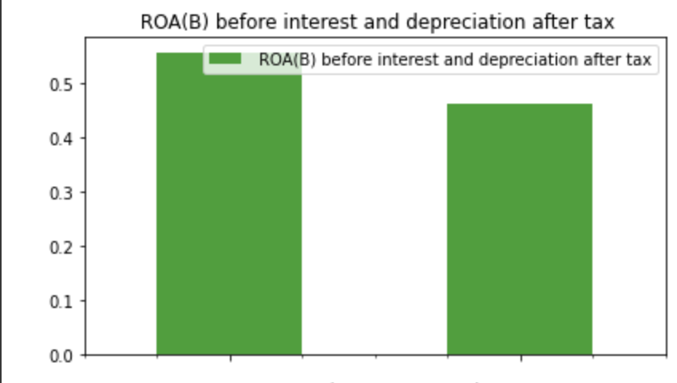
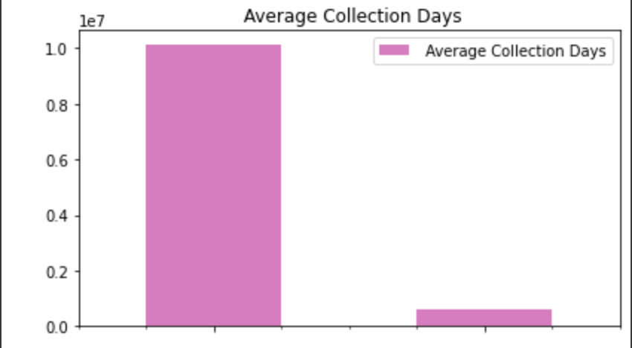
INITIAL FINDINGS
Return on Assets for the company that going to bankrupt is lower.
Has a good performance in collecting their cash

Slide 4
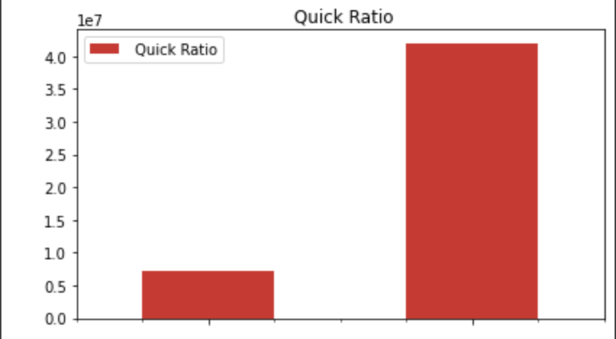
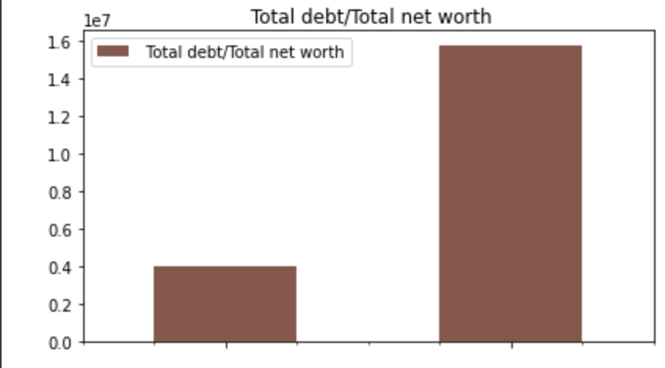
INITIAL FINDINGS
Quick Ratio is Higher.
Total Debt / Total Net Worth is Higher

Slide 5
MODEL
Data Source:
https://www.kaggle.com/datasets/fedesoriano/company-bankruptcy-prediction
MODEL USED
Random Forest Classifier
Hyperparameter Tuning
The sample leaf, sample split, max depth and n estimators using GridSearchCV
Applying PCA to speed up Machine Learning

Slide 6
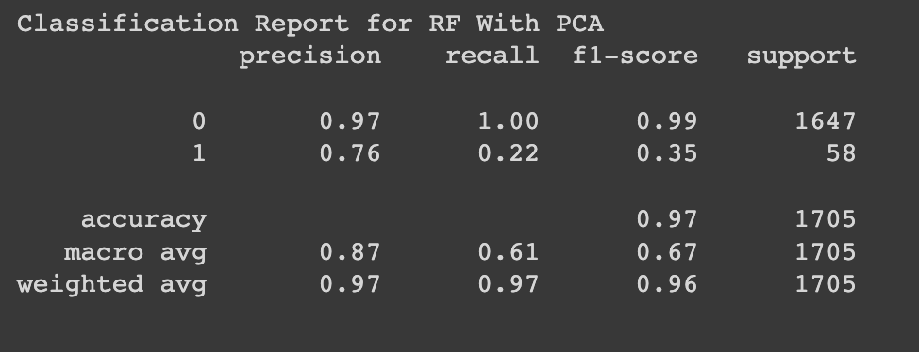
RESULT

Slide 7
FUTURE IMPROVEMENT
Industry TYPE OF EACH COMPANY
ECONOMIC CONDITION

